Slide 1

BRIEF ON EASE OF DOING BUSINESS REFORMS IN DELTA STATE
l
Hon. Anthony Emeka Elekeokwuri
Director General
Delta State Investments Development Agency

Slide 2
OVERVIEW
Delta State Government is committed to prioritize reforms that will enhance Ease of Doing Business, Expand Critical Infrastructure and Stimulate Sustainable Growth. The Delta State Government under the good leadership of His Excellency the Governor, Rt Hon. Elder Sheriff Oborevwori through its M.O.R.E Agenda for Renewed Hope is working closely with members of the Organized Private Sectors like DACCIMA, NASSI, MAN, and other Economic Institutions to stimulate Trade and attract investments to the State given the State’s vast Areas of Investment Opportunities.

Slide 3
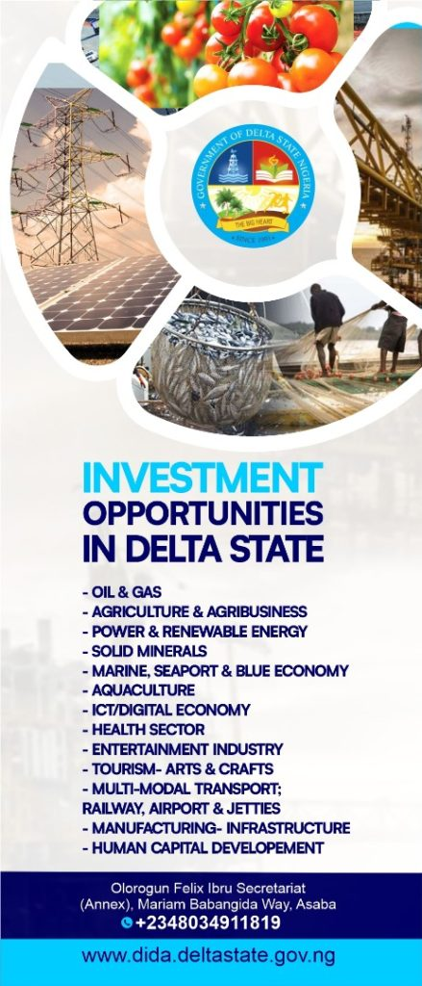
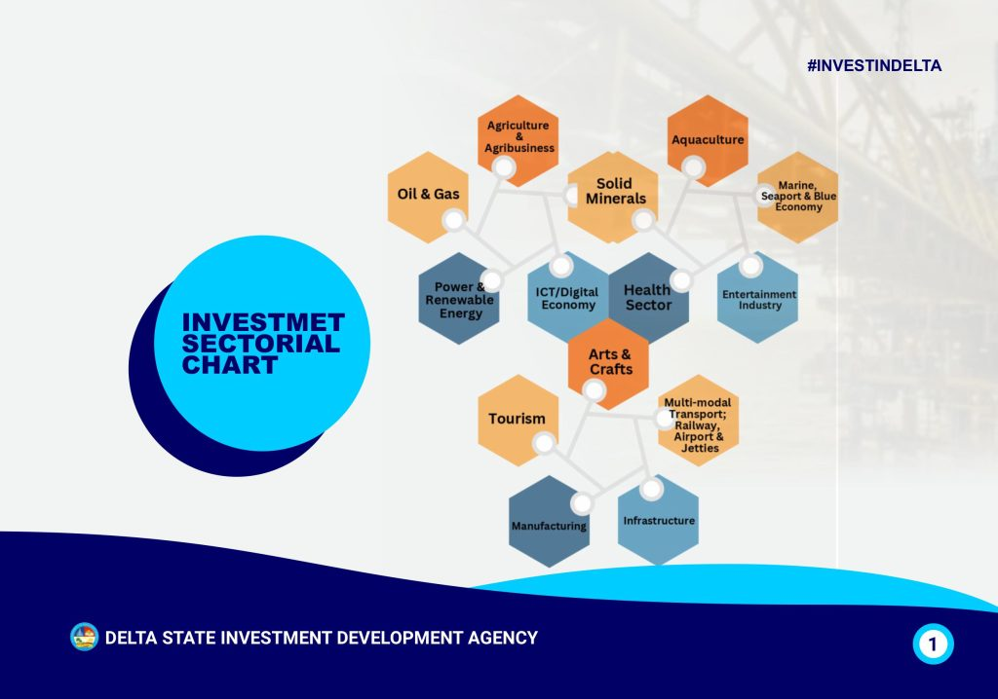
TOP TEN(10) AREAS OF INVESTMENT OPPORTUNITIES IN THE STATE

Slide 4
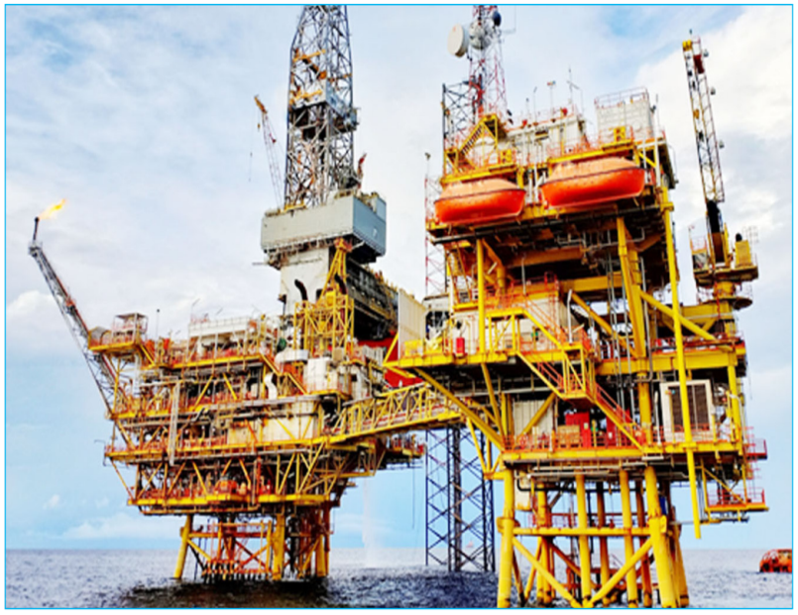
OIL & GAS: a. Gas to Power b. Gas to LPG c. Establishment of Methanol-ethanol Plant

Slide 5
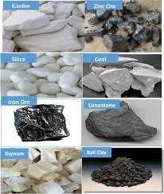
2. SOLID MINERALS: Silica, Kaolin, Lignite (Brown coal), Clay a. Establishment of Ceramic and Tiles Industries b. Investment in Glass Production( hollow & flat sheets) c. Coal to Power Genration

Slide 6
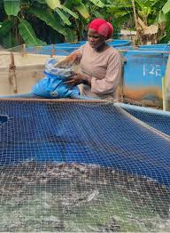
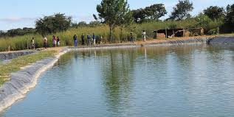
3. AQUACULTURE- Investment in establishment of a. Cold Stores , Trucks and Fishing Trolleys b. Fish feed mills c. Fish Hatcheries

Slide 7
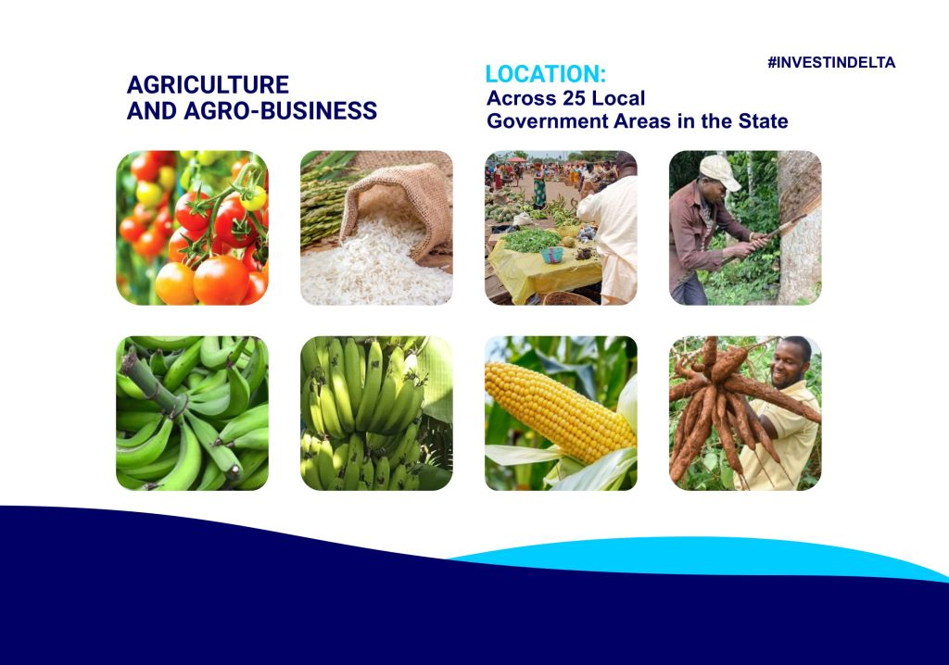
4. AGRICULTURE & AGRO-PROCESSING: There is opportunity for investment in Oil palm full value chain through the establishment of an Oil Palm Common Facility Center, Cassava-Starch Processing Plant, Tomato Processing Industry, Rice Mills, and Poultry feed mills. Agro Industrial Park: The State has an Agro Industrial Park located at Aboh-Ogwuashuku with good access road and other necessary infrastructure.

Slide 8
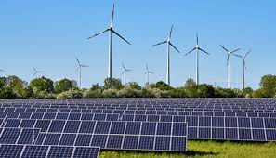
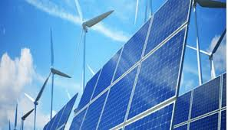
5. RENEWABLE ENERGY: Delta State has huge Investment Opportunities in the Production of- a. Bio-fuels b. Wind Power

Slide 9
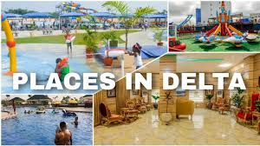
6. TOURISM: River Ethiope is adjudged the Deepest Inland Water Way in Africa. There are other numerous Tourist Sites in the State great for tourism

Slide 10
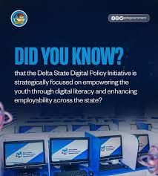
7. DIGITAL ECONOMY: Investment opportunities in Fibre Optic Infrastructure to deliver broad band connection to Private Sectors, Numerous Tertiary & Basic Educational Institutions, Hospitals and our Airports for increased Internet Service Spread

Slide 11
COMPETITIVE ADVANTAGES OF DELTA STATE
I. GEOGRAPHY - Delta State is strategically located in the South-South Geo-political Zone of Nigeria. It is the only State with 6 Economic/Commercial Nerve Centers: Warri, Ughelli, Agbor, Kwale, Sapele and Asaba. As an Oil & Gas rich State, it produces over 30% of the Country’s Oil & Gas which accounts for a significant amount of the Country’s current foreign exchange earnings. Delta State straddles the Atlantic coast and it is bounded in the East by 3 States-Anambra, Imo, and Rivers State, in the North/North West – Edo and Ondo and in the South –Bayelsa.
Total area- 18,050 Sq. KM
Land coverage – 60%,
Large Coastline – 163KM (40%)
II. DEMOGRAPHY - 6,527,543 {Male- 3.279,210; Female – 2,958,557} Active youth population of over 67%

Slide 12
III. FOUR (4) SEAPORTS AND TWO (2) PETROLEUM TERMINALS: Delta State is the only State in Nigeria with 4 Seaports.
a) Seaports: Koko, Warri, Burutu, and Sapele
b) Petroleum Terminals: Forcados and Escravos
c) Deepest Inland Water Way in Africa: River Ethiope
IV. INTERNATIONAL AIRPORTS: Delta State has three(3) Airports
a. Asaba International &Cargo Airport
b. Osubi Airport
c. Escravos Airport
V. RAILWAY- there exist a railway from Warri-Agbor-Abuja
VI. ABUNDANT NATURAL &MINERAL RESOURCES
a. Crude oil
b. Gas
c. Lignite (Brown coal)
d. Silica (Premium quality)
e. Kaolin (Commercial quantity)
f. Clay (Commercial quantity)

Slide 13
VII. AGRICULTURAL PRODUCE
a. Oil palm
b. Cassava
c. Maize
d. Tomatoes
e. Rice
f. Vegetables
VII CLEMENT WEATHER & GREEN VEGETATION- Our Tropical savannah & Massive Vegetation with abundant sunshine and rain.
IX ECONOMIC TRADE ZONES- Koko free Trade Zone which operates as a free Trade Zone and Export Processing Zone. Also the Kwale Industrial Park & Aboh Ogwashi-uku Agro processing Park.
X. NUMEROUS TERTIARY INSTITUTIONS: Delta State has numerous Tertiary Institutions.
• Four (4) State Universities
• Two (2) Federal Universities
• Twelve (12) Private Universities
• Three (3) Polytechnic
• Seven (7)Colleges of Education
• Fourteen(15) Tech Schools

Slide 14
XI. NATURAL ENDOWMENT/ TOURIST SITE: Delta State has Numerous Tourist Site namely:
A. Historical Sites:
Mungo Park House: A national museum showcasing the state's rich history.
Nana's Palace: A 19th-century palace built by Nana Olomu, an Itsekiri chief and merchant.
Lander Brothers’ Anchorage: A historic site commemorating the Lander brothers'.
Araya Bible Site: A sacred site believed to be the location where a Bible miraculously descended from heaven.
B. Natural Attractions:
River Ethiope Source at Umuaja, Ukwani LGA: A spot with crystal-clear waters perfect for swimming, boating, and fishing.
Kwale Game Reserve: A wildlife reserve offering a glimpse into Nigeria's diverse flora and fauna.
Otuogu Beach: A picturesque beach with stunning views of the Niger Delta.
C. Recreational Centers:
Effurun Garden Park: A serene park ideal for picnics and relaxation.
Water Park, Agbor: An amusement park offering thrilling rides and games for all ages.
Asaba Leisure Park,Asaba

Slide 15
KEY POLICY INITIATIVES AND EASE OF DOING BUSINESS REFORMS IN DELTA STATE

Slide 16
1. DELTA STATE EASE OF DOING BUSINESS REFORMS
More than ever before the Delta State Government has created the environment for improved Ease of Doing Business (EODB). Improved business friendly conditions in the State are as a result of deliberate measures and Policies in the various spheres of business environment viz;
Good governance and political stability as the State has become more peaceful.
Sound economic management
Promotion of Public Private Partnership (PPP) via the establishment of the Delta State Investments Development Agency.
Automated Central Billing System of Taxes and Levies etc.
Delta State Security Committee under the Chairmanship of the State Governor- for curbing crime and guaranteeing security, law and order for businesses.

Slide 17
f) Delta State Anti-Kidnapping Law 2016-to curb incidence of kidnapping
g) Delta State Public and Private Properties Protection Law to curb the incessant harassment of property owners and developers.
h) Establishment of 6 Small Claims Court for resolution of Commercial disputes.
i) Setting up of the Delta State Ease of Doing Business Council chaired by the Governor and assigning of focal persons from relevant Ministries, Departments and Agencies etc.
j) Intermediating between investors and the host communities .
k) Grant of waivers from payment of rates, fees, levies and other charges for investors for up to 5years after commencement of business.

Slide 18
l) Helping investors with appropriate pool of man power resources through the Delta State Bureau for Job and Wealth Creation, Delta State Technical and Vocational Board and Delta State Investments Development Agency.
m) Delta State Electricity Power Law 2025.
n) Delta State Environmental Protection Agency
o) Delta State Environmental Conservation Law
p) Delta State Forestry Law
q) Operation Delta Sweep to enhance joint security operations in the State.

Slide 19
2. HEALTH SECTOR INITIATIVES
Delta State Contributory Health Commission (DSCHC): Established to ensure access to quality healthcare services for all residents of Delta State, irrespective of their socio-economic status.
Delta State Contributory Health Scheme (DSCHS): A mandatory health insurance scheme that provides financial protection to residents of Delta State.
3. RENEWABLE ENERGY INITIATIVES
Delta State Renewable Energy Policy Roadmap: Aims to promote the use of renewable energy sources in the state, such as solar and wind power.
4. SOCIO-ECONOMIC DEVELOPMENT INITIATIVES
Socio-Economic Development Programs: The State government is committed to promoting socio-economic development through innovative programs and policies.

Slide 20
5. OPERATION DELTA SANITY (OPDS)
Launched to combat oil theft in the Niger Delta region, this operation is a collaborative effort between the Nigerian Petroleum Ministry and the Navy. The initiative has been bolstered with armed drones, attack helicopters and enhanced intelligence to increase oil production and secure state resources.

Slide 21
